Slide 1

Advanced GUI Calculator
NAME: Devanshu Mundhiyara DATE: MAY 2025
NextHikes IT Solutions

Slide 2


Introduction
What is this project?
This project is a desktop application designed to perform calculations using Python. It offers both Standard and Scientific modes, catering to various user needs. The user interface has a modern and sleek design, featuring a dark theme that enhances usability and visual appeal, making it attractive for general purposes and advanced mathematical computations.

Slide 3

Key Features
What we created:
What makes it distinct:
This advanced GUI calculator supports standard operations like addition, subtraction, multiplication, and division alongside scientific functions such as sine, cosine, logarithms, and more. Memory features streamline your calculations.
The calculator offers dual modes for standard and scientific calculations, enhanced by a sleek dark mode UI. It features smooth keyboard input handling, backspace functionality, and an intuitive, responsive layout for easy user interaction.

Slide 4

Libraries Used
Primary Libraries:
This calculator utilizes two main libraries: 'customtkinter' for creating a sleek and user-friendly GUI, enabling customization of its components, and 'math' for performing complex mathematical operations. Together, they enhance the user experience by integrating advanced functionalities with an appealing interface.

Slide 5
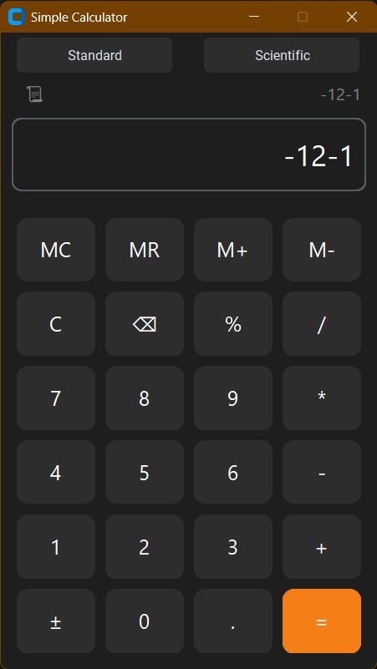
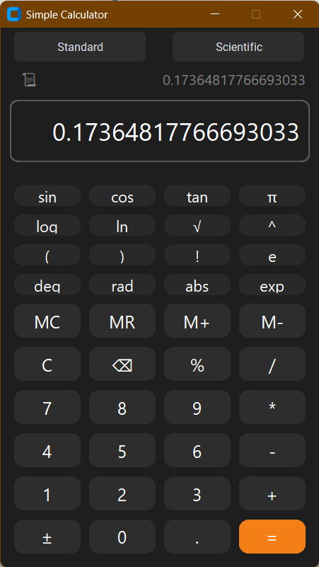
Screenshots

Slide 6
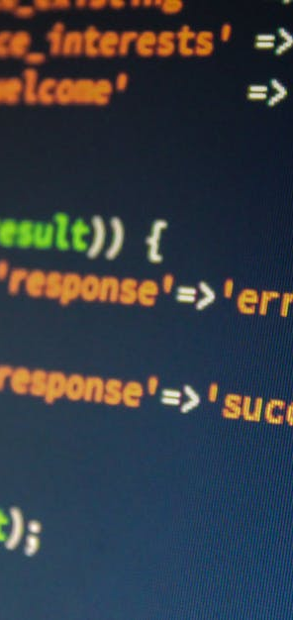
Challenges Encountered
Challenges:
Mapping keyboard inputs to button functions accurately.
Handling edge cases in scientific calculations (e.g., log of negative numbers).
Creating a scrollable, toggle-able history dropdown.
Managing UI transitions between modes (Standard ↔ Scientific).
How we overcame them:
Used smart key-to-function mappings in keyboard_press().
Wrapped risky math operations with try-except.
Used winfo_rootx/y and place() for correct positioning of history dropdown.
Dynamically destroyed and rebuilt buttons for mode switching.

Slide 7
References
CustomTkinter Documentation Tom Schimansky – Official GitHub Repository https://github.com/TomSchimansky/CustomTkinter.
Python Math Module Documentation Python.org – Standard Library Reference https://docs.python.org/3/library/math.html
Stack Overflow Community Help Used when resolving input handling issues and debugging eval() errors. "How to safely use eval in a calculator?"
Tkinter Modern Calculator | Python GUI Calculator | Custom Tkinter Calculator
Tkinter Hub
https://www.youtube.com/watch?v=I4bhsfWSBoc

Slide 8
Thank You
Questions and feedback are welcome.

